Slide 1
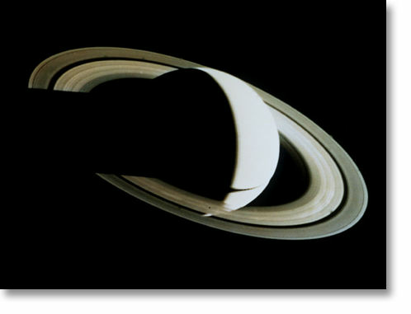
Cassini Mission
Cassini is the first spacecraft ever to orbit Saturn.
Four previous missions have flown past Saturn, including the famous Voyager probes, taking valuable data as they went.
These reconnaissance missions have answered many questions, but have raised new ones that Cassini is designed to answer.

Slide 2
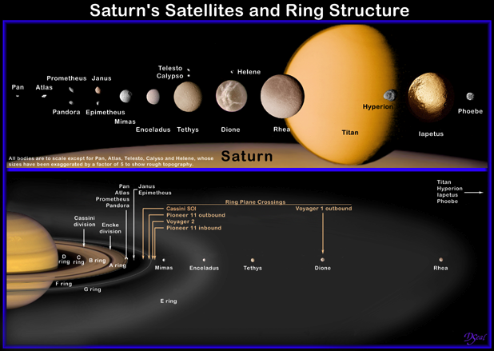
Cassini Mission
We have discovered 45 moons of Saturn so far. They vary in size, shape and complexity. The largest, Titan, is the most mysterious. It is shrouded with methane clouds so we cannot see the surface with our eyes. Cassini is equipped to take pictures in light wavelengths we cannot see, in order to discover what is on the surface

Slide 3
Cassini Mission
Saturn has 7 ring regions, named A through G.
Note that the rings are named in order of discovery, not distance from Saturn, so the first rings discovered by Giovanni Cassini are A and B while the most recent rings discovered by Voyager are labeled F and G.
The distance order is: D, C, B, A, F, G, E.

Slide 4
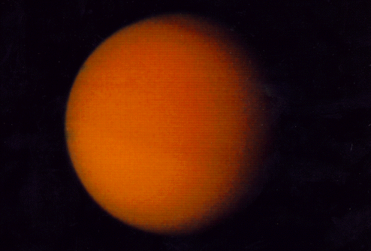
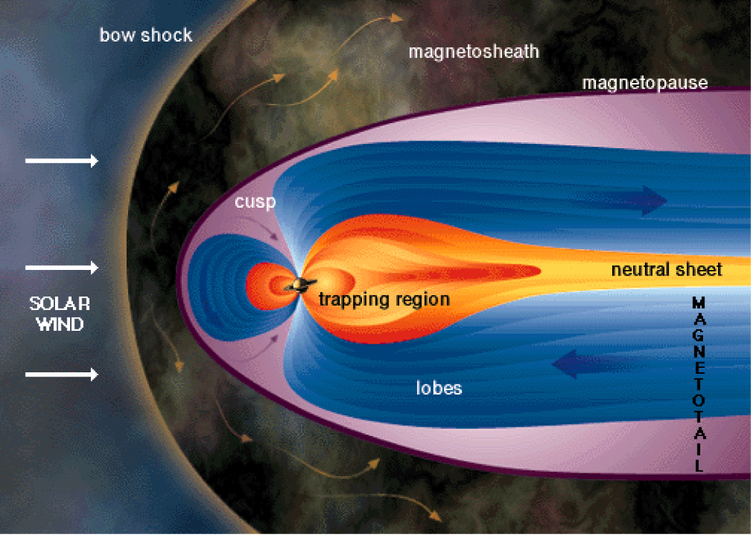
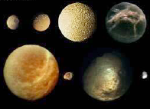
Cassini Mission
Thus Cassini was given four main targets
Saturn and its rings
Titan
Saturn's magnetic field
Saturn's icy moons

Slide 5
Cassini Mission
The mission was designed in two parts, an orbiter (called Cassini) to explore the Saturnian system and a probe (called Huygens) to crash onto Titan. The Cassini orbiter has five types of instruments:
  Four instruments to "see" in three kinds of light,
  One system to create radar images,
  Instruments for measuring dust particles, radio waves, and plasma waves,
  Machines for measuring the magnetic fields in space and around Saturn,
  Instruments to measure particles near the spacecraft.

Slide 6
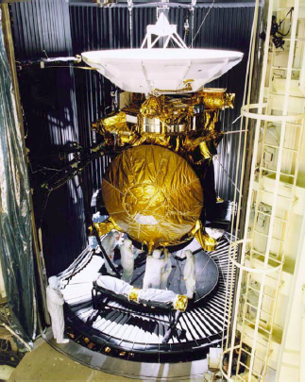
Cassini Mission
The combined Cassini-Huygens spacecraft is the second largest interplanetary spacecraft ever built (22 feet tall and 5,348 lbs).
Cassini was built by NASA at the Jet Propulsion Laboratory in California. But the Huygens probe (the orange foil circle in the image) was built by the European Space Agency then incorporated into Cassini at JPL.

Slide 7
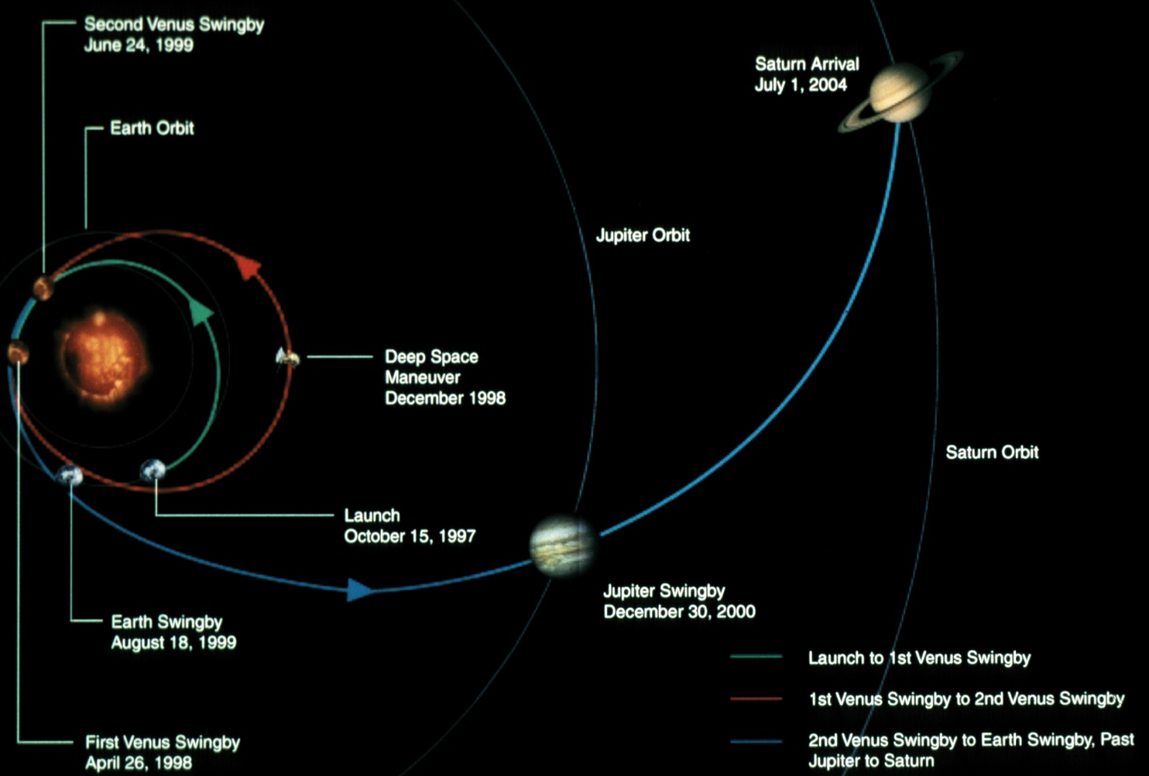
Cassini's Journey
To save fuel (which saves taxpayers' dollars), Cassini took the long way to Saturn. It swung by Earth and Venus twice, sling-shotting past the planets to gain speed. Then it went through the asteroid belt, swinging around Jupiter for a gravity assist out to Saturn.
This whole process took 7 years

Slide 8
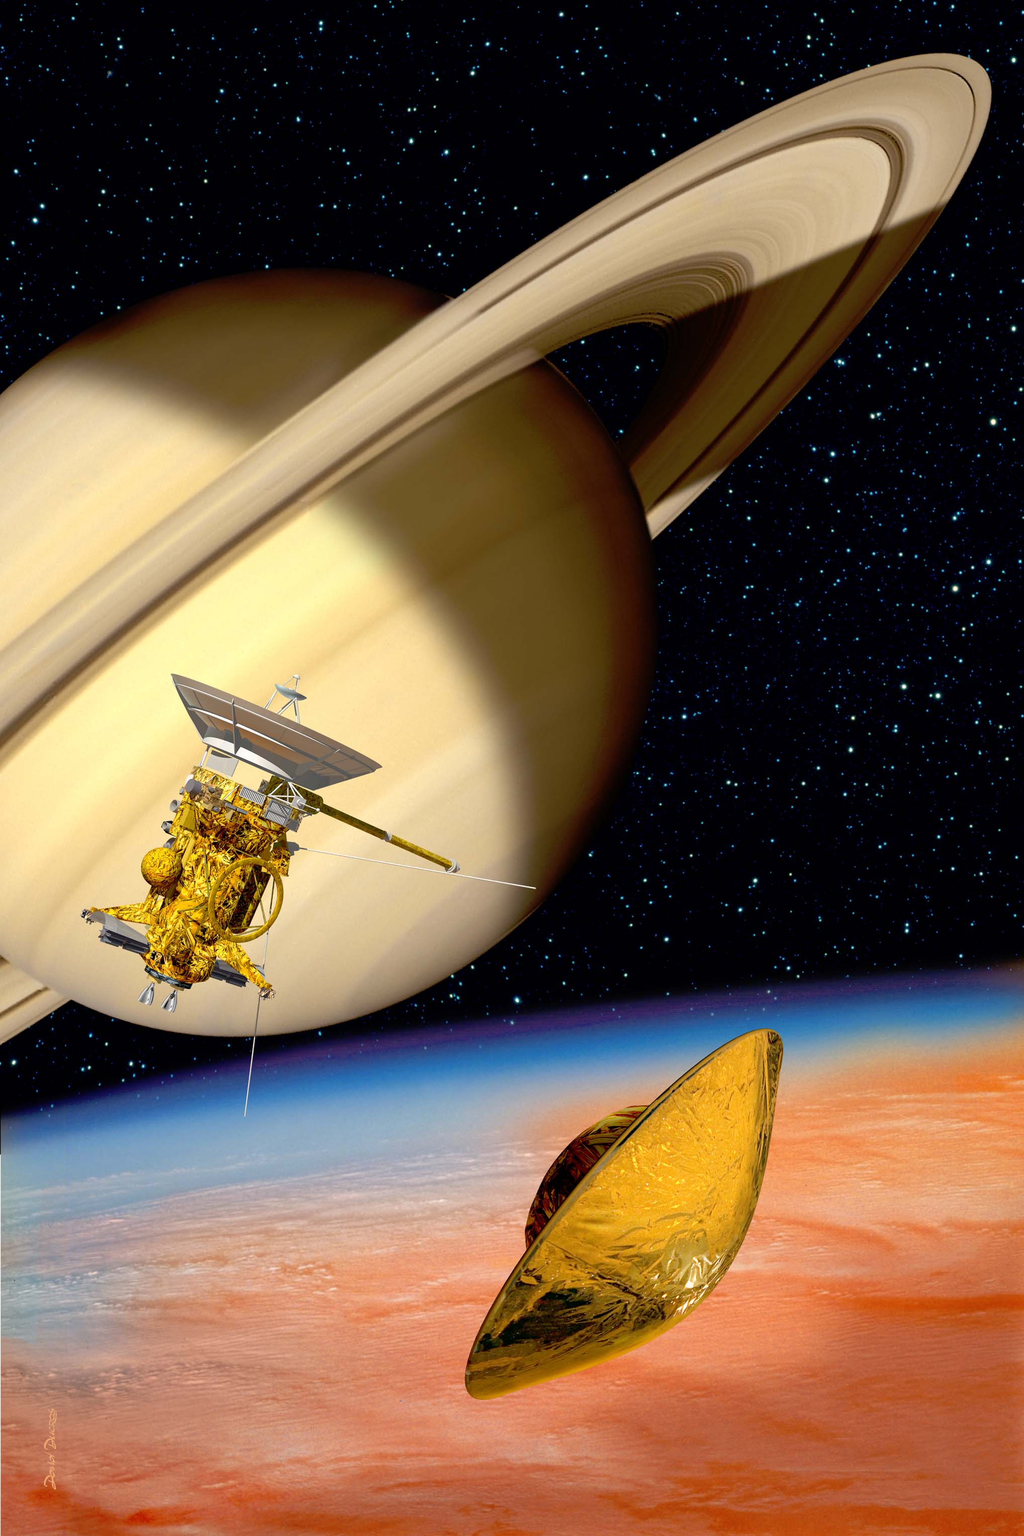
After it successfully arrived in July 2004, Cassini is spending four years in orbit around Saturn. The spacecraft will make ~ 74 orbits of Saturn, and 45 flybys of Titan.
Orbits range in length from 7 to 116 days and Cassini will be 98,036 to 592,422 miles away from Saturn.
The Huygens probe detached from the Cassini orbiter in Dec. 2004, and entered the atmosphere of Saturn’s moon, Titan, on January 14, 2005.
As it descended, the probe gathered information about Titan’s atmosphere and surface.

Slide 9
Cassini Timetable
Date | Significant Event
July 1, 2004 | Insertion into Saturn orbit
October 26, 2004 | First close flyby of Titan
December 25, 2004 | Huygens probe separated from Cassini
January 14, 2005 | Huygens descends into Titan's atmosphere (begins 5 a.m. EST).
August 1, 2005 | Mimas flyby.
September 23, 2005 | Tethys flyby.
September 25, 2005 | Hyperion flyby
October 10, 2005 | Dione flyby
November 25, 2005 | Rhea flyby
2006-2007 | Multiple Titan flybys
December 3, 2007 | Epimetheus flyby

Slide 10
Cassini Mission
To find more about the Cassini mission's discoveries so far, return to the main menu and click Cassini Mission Results: Saturn, Saturn's Rings, Saturn's moons, or Titan.
You can also find more information at home by using Cassini's homepage: http://saturn.jpl.nasa.gov/home/index.cfm

